Slide 1

Welcome to the PowerPoint Presentation.
Organization- Nexthikes IT Solutions
Topic- Python Calculator
Presented By- Nischay Kumar Gautam

Slide 2
Introduction Calculator is a device or software tool used to perform mathematical operations, ranging from basic arithmetic to complex calculations. There are two types of calculator : 1. Simple Calculator 2. Scientific or Advance Calculators

Slide 3
Basic Arithmetic Operations
Functions for Addition (+)
Functions for Subtraction (-)
Functions for division (/)
Function for square Root (
Function for Multiplication (*)
Function for Percentage (%)
Function for Backspace
Function for “Equals to” (=)

Slide 4
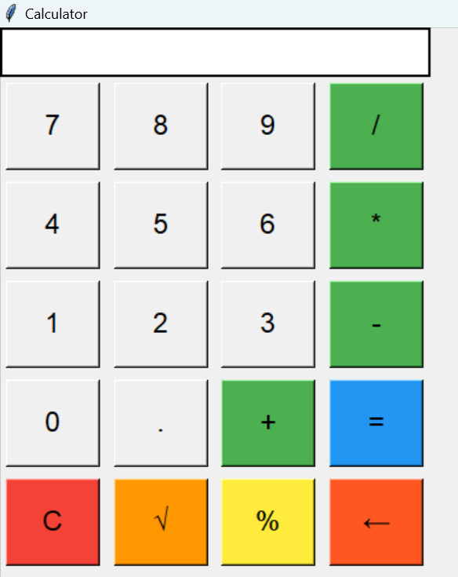
Visual Representation of the Calculator Prepared

Slide 5
References
Courses and trainings provided by Digicrome Academy.
Tkinter Library for creating GUI elements.
Python Documentation on data types, arithmetic operators, input function, conditional statements.
Other online websites.

Slide 6
Challenges
A simple calculator in Python is n excellent project for beginners and advanced programmers. The Process of making a calculator involves some basic programming concepts. This includes taking users input, conditional statements, and functions.
Since I am from non IT background, initial stages of coding is quite challenging however I am working the best way possible to adapt the new learning through practices.
I came to a resolution to always make one and half hour of my day dedicating to learning python. It might not be much but my progress has greatly improved.

Slide 7
Thank you!!!

